Slide 1
— Module 3 —
Classification
Course Outcomes
ITC602.4: Implement the appropriate data mining methods like classification, clustering or Frequent Pattern mining on large data sets.
ITC602.5: Define and apply metrics to measure the performance of various data mining algorithms.

Slide 2
Module 3. Classification
What is classification? What is prediction?
Issues regarding classification and prediction
1. Classification by decision tree induction
Attribute Selection measures
Tree pruning
2. Bayesian classification
Naive Bayes classifier
Rule-based classification, SVM, Backpropagation, k-Nearest-Neighbor classifiers, GA, fuzzy set
Prediction : structure of regression models
Simple linear regression
Accuracy and error measures
Evaluating the Accuracy
03/30/21
Data Mining: Concepts and Techniques

Slide 3
Classification vs. Prediction
Classification
  predicts categorical class labels (discrete,unordered)
  classifies data (constructs a model) based on the training set and the values (class labels) in a classifying attribute and uses it in classifying new data
  Ex. Classification model to categorize bank loan applications as either safe or risky
Prediction
  models continuous-valued functions, i.e., predicts unknown or missing values
  Ex. Prediction model to predict the expenditures in dollars of potential customers on computer equipment given their income and occupation
Data Mining: Concepts and Techniques
03/30/21

Slide 4
Typical applications
  Credit approval/ Performance approval
  Target marketing
  Medical diagnosis
  Manufacturing
  Fraud detection
03/30/21
Data Mining: Concepts and Techniques

Slide 5
Classification—A Two-Step Process
1. Learning Step / Training Phase :
Classifier is built describing a predetermined set of classes/concepts
  Classification algorithm builds the classifier by analyzing or “learning from” a training set made up of database tuples /sample and their associated class label attribute
  The class label attribute is discrete-valued and unordered
  The model is represented as classification rules, decision trees, or mathematical formulae
03/30/21
Data Mining: Concepts and Techniques

Slide 6
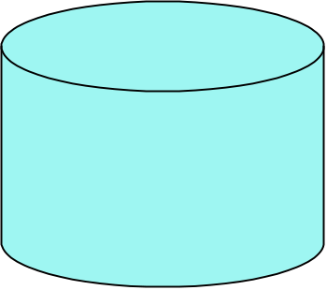
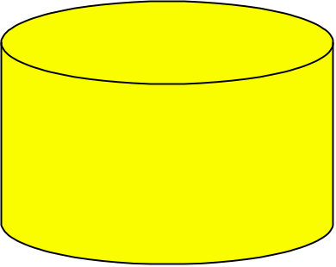

Process (1): Model Construction
Classification
Algorithms
Training
Data
Classifier
(Model)
IF rank = ‘professor’
OR years > 6
THEN tenured = ‘yes’
03/30/21
Data Mining: Concepts and Techniques

Slide 7
Classification—A Two-Step Process
2. Model usage: for classifying future or unknown data
  Estimate accuracy of the model
    The known label of test sample is compared with the classified result from the model
    Accuracy rate is the percentage of test set samples that are correctly classified by the model
    Test set is independent of training set
  If the accuracy is acceptable, use the model to classify data tuples whose class labels are not known
03/30/21
Data Mining: Concepts and Techniques

Slide 8
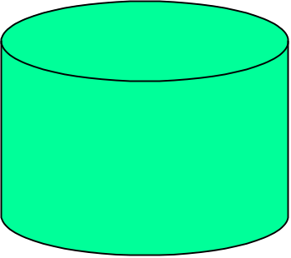
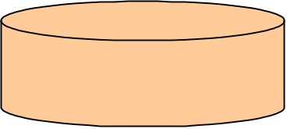


Process (2): Using the Model in Prediction
Classifier
Testing
Data
Unseen Data
(Jeff, Professor, 4)
Tenured?
03/30/21
Data Mining: Concepts and Techniques

Slide 9
Supervised vs. Unsupervised Learning
Supervised learning (classification)
  Supervision: The training data (observations, measurements, etc.) are accompanied by labels indicating the class of the observations
  New data is classified based on the training set
Unsupervised learning (clustering)
  The class labels of training data is unknown
  Given a set of measurements, observations, etc. with the aim of establishing the existence of classes or clusters in the data
03/30/21
Data Mining: Concepts and Techniques

Slide 10
Chapter 5. Classification and Prediction
What is classification? What is prediction?
Issues regarding classification and prediction
Classification by decision tree induction
Bayesian classification
Rule-based classification
Classification by back propagation
Support Vector Machines (SVM)
Associative classification
Lazy learners (or learning from your neighbors)
Other classification methods
Prediction
Accuracy and error measures
Ensemble methods
Model selection
Summary
03/30/21
Data Mining: Concepts and Techniques

Slide 11
Data Preparation
Data cleaning
  Preprocess data in order to reduce noise and handle missing values
Relevance analysis (Attribute/feature selection)
  Remove the irrelevant or redundant attributes
Data transformation and reduction
  Generalize and/or normalize data
03/30/21
Data Mining: Concepts and Techniques

Slide 12
Comparing Classification and Prediction Methods
Accuracy
  classifier accuracy: predicting class label
  predictor accuracy: guessing value of predicted attributes
Speed
  time to construct the model (training time)
  time to use the model (classification/prediction time)
Robustness: handling noise and missing values
Scalability: efficiency in disk-resident databases
Interpretability
  understanding and insight provided by the model
Other measures, e.g., goodness of rules, such as decision tree size or compactness of classification rules
03/30/21
Data Mining: Concepts and Techniques

Slide 13
Chapter 6. Classification and Prediction
What is classification? What is prediction?
Issues regarding classification and prediction
Classification by decision tree induction
Bayesian classification
Rule-based classification
Classification by back propagation
Support Vector Machines (SVM)
Associative classification
Lazy learners (or learning from your neighbors)
Other classification methods
Prediction
Accuracy and error measures
Ensemble methods
Model selection
Summary
03/30/21
Data Mining: Concepts and Techniques

Slide 14
Module 3. Classification
What is classification? What is prediction?
Issues regarding classification and prediction
1. Classification by decision tree induction
Attribute Selection meaures
Tree pruning
2. Bayesian classification
Naive Bayes classifier
Rule-based classification, SVM, Backpropagation, k-Nearest-Neighbor classifiers, GA, fuzzy set
Prediction : structure of regression models
Simple linear regression
Multiple linear regression
Accuracy and error measures
Evaluating the Accuracy
03/30/21
Data Mining: Concepts and Techniques

Slide 15
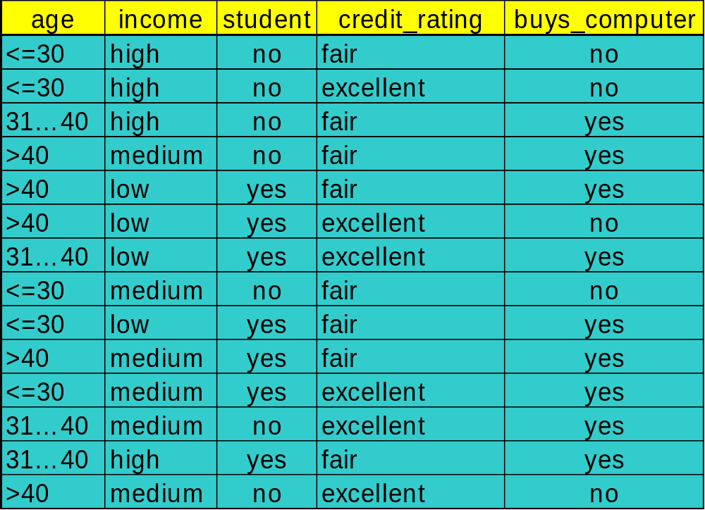
Decision Tree Induction: Training Dataset
03/30/21
Data Mining: Concepts and Techniques

Slide 16
Output: A Decision Tree for “buys_computer”
age?
<=30
overcast
>40
31..40
student?
yes
credit rating?
no
yes
excellent
fair
no
yes
no
yes
03/30/21
Data Mining: Concepts and Techniques

Slide 17
Algorithm for Decision Tree Induction
Basic algorithm (a greedy algorithm)
  Tree is constructed in a top-down recursive divide-and-conquer manner
  At start, all the training examples are at the root
  Attributes are categorical (if continuous-valued, they are discretized in advance)
  Examples are partitioned recursively based on selected attributes
  Test attributes are selected on the basis of a heuristic or statistical measure (e.g., information gain)
Conditions for stopping partitioning
  All samples for a given node belong to the same class
  There are no remaining attributes for further partitioning – majority voting is employed for classifying the leaf
  There are no samples left
03/30/21
Data Mining: Concepts and Techniques

Slide 18
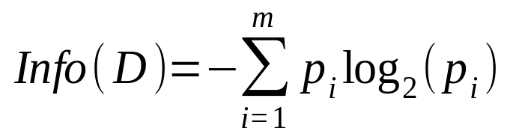
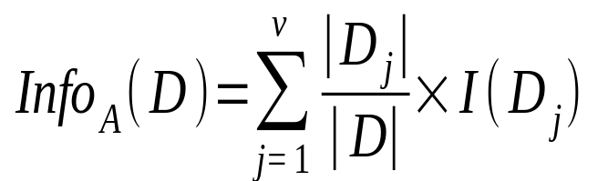
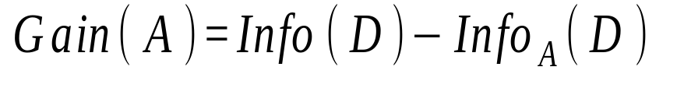
Attribute Selection Measure: Information Gain (ID3/C4.5)
Select the attribute with the highest information gain
Let p_{i} be the probability that an arbitrary tuple in D belongs to class C_{i}, estimated by |C_{i, D}|/|D|
Expected information (entropy) needed to classify a tuple in D:
Information needed (after using A to split D into v partitions) to classify D:
Information gained by branching on attribute A
03/30/21
Data Mining: Concepts and Techniques
Notes:
I : the expected information needed to classify a given sample
E (entropy) : expected information based on the partitioning into subsets by A

Slide 19
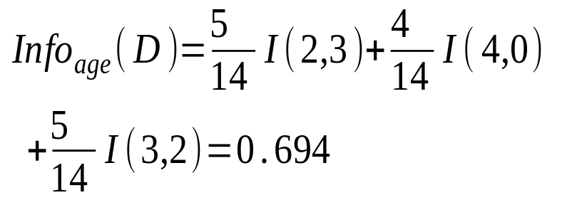
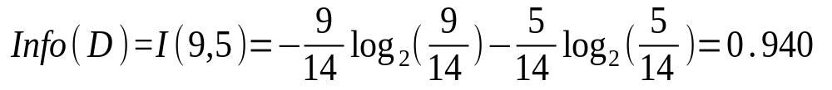

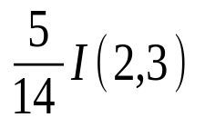
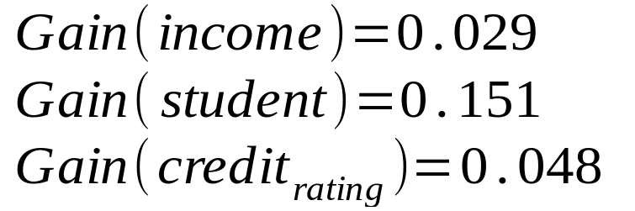
Attribute Selection: Information Gain
Class P: buys_computer = “yes”
Class N: buys_computer = “no”
means “age <=30” has 5 out of 14 samples, with 2 yes’es and 3 no’s. Hence
Similarly,
03/30/21
Data Mining: Concepts and Techniques

Slide 20
Computing Information-Gain for Continuous-Value Attributes
Let attribute A be a continuous-valued attribute
Must determine the best split point for A
  Sort the value A in increasing order
  Typically, the midpoint between each pair of adjacent values is considered as a possible split point
    (a_{i}+a_{i+1})/2 is the midpoint between the values of a_{i} and a_{i+1}
  The point with the minimum expected information requirement for A is selected as the split-point for A
Split:
  D1 is the set of tuples in D satisfying A ≤ split-point, and D2 is the set of tuples in D satisfying A > split-point
03/30/21
Data Mining: Concepts and Techniques

Slide 21
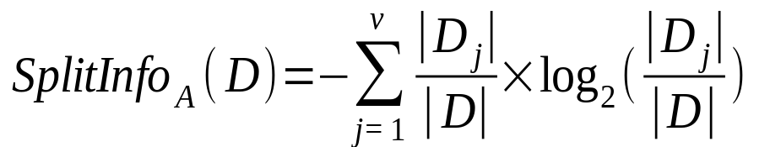
Gain Ratio for Attribute Selection (C4.5)
Information gain measure is biased towards attributes with a large number of values
C4.5 (a successor of ID3) uses gain ratio to overcome the problem (normalization to information gain)
  GainRatio(A) = Gain(A)/SplitInfo(A)
Ex.
  gain_ratio(income) = 0.029/0.926 = 0.031
The attribute with the maximum gain ratio is selected as the splitting attribute
03/30/21
Data Mining: Concepts and Techniques

Slide 22
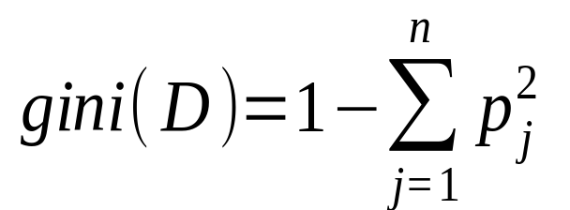
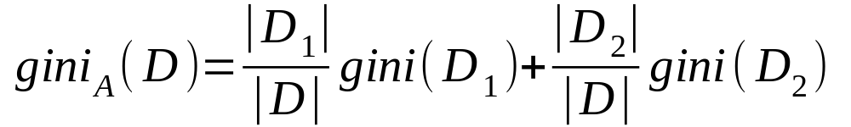
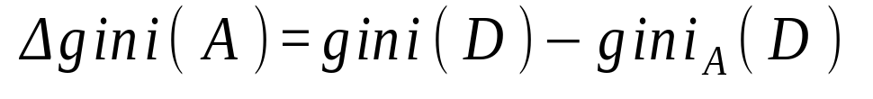
Gini index (CART, IBM IntelligentMiner)
If a data set D contains examples from n classes, gini index, gini(D) is defined as
where p_{j} is the relative frequency of class j in D
If a data set D is split on A into two subsets D₁ and D₂, the gini index gini(D) is defined as
Reduction in Impurity:
The attribute provides the smallest gini_{split}(D) (or the largest reduction in impurity) is chosen to split the node (need to enumerate all the possible splitting points for each attribute)
03/30/21
Data Mining: Concepts and Techniques

Slide 23
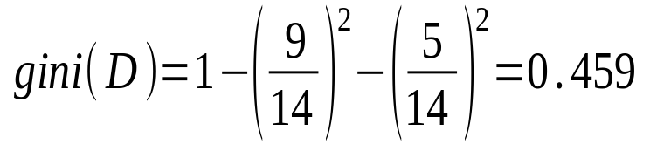
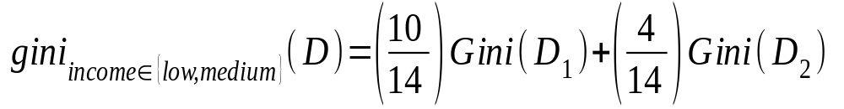
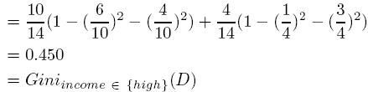
Gini index (CART, IBM IntelligentMiner)
Ex. D has 9 tuples in buys_computer = “yes” and 5 in “no”
Suppose the attribute income partitions D into 10 in D₁: {low, medium} and 4 in D₂
  but gini_{{medium,high}} is 0.30 and thus the best since it is the lowest
All attributes are assumed continuous-valued
May need other tools, e.g., clustering, to get the possible split values
Can be modified for categorical attributes

Slide 24
Comparing Attribute Selection Measures
The three measures, in general, return good results but
  Information gain:
    biased towards multivalued attributes
  Gain ratio:
    tends to prefer unbalanced splits in which one partition is much smaller than the others
  Gini index:
    biased to multivalued attributes
    has difficulty when # of classes is large
    tends to favor tests that result in equal-sized partitions and purity in both partitions
03/30/21
Data Mining: Concepts and Techniques

Slide 25
Other Attribute Selection Measures
CHAID: a popular decision tree algorithm, measure based on χ² test for independence
C-SEP: performs better than info. gain and gini index in certain cases
G-statistics: has a close approximation to χ² distribution
MDL (Minimal Description Length) principle (i.e., the simplest solution is preferred):
  The best tree as the one that requires the fewest # of bits to both (1) encode the tree, and (2) encode the exceptions to the tree
Multivariate splits (partition based on multiple variable combinations)
  CART: finds multivariate splits based on a linear comb. of attrs.
Which attribute selection measure is the best?
  Most give good results, none is significantly superior than others
03/30/21
Data Mining: Concepts and Techniques

Slide 26
Overfitting and Tree Pruning
Overfitting: An induced tree may overfit the training data
  Too many branches, some may reflect anomalies due to noise or outliers
  Poor accuracy for unseen samples
Two approaches to avoid overfitting
  Prepruning: Halt tree construction early—do not split a node if this would result in the goodness measure falling below a threshold
    Difficult to choose an appropriate threshold
  Postpruning: Remove branches from a “fully grown” tree—get a sequence of progressively pruned trees
    Use a set of data different from the training data to decide which is the “best pruned tree”
03/30/21
Data Mining: Concepts and Techniques

Slide 27
Enhancements to Basic Decision Tree Induction
Allow for continuous-valued attributes
  Dynamically define new discrete-valued attributes that partition the continuous attribute value into a discrete set of intervals
Handle missing attribute values
  Assign the most common value of the attribute
  Assign probability to each of the possible values
Attribute construction
  Create new attributes based on existing ones that are sparsely represented
  This reduces fragmentation, repetition, and replication
03/30/21
Data Mining: Concepts and Techniques

Slide 28
Classification in Large Databases
Classification—a classical problem extensively studied by statisticians and machine learning researchers
Scalability: Classifying data sets with millions of examples and hundreds of attributes with reasonable speed
Why decision tree induction in data mining?
  relatively faster learning speed (than other classification methods)
  convertible to simple and easy to understand classification rules
  can use SQL queries for accessing databases
  comparable classification accuracy with other methods
03/30/21
Data Mining: Concepts and Techniques

Slide 29
Scalable Decision Tree Induction Methods
SLIQ (EDBT’96 — Mehta et al.)
  Builds an index for each attribute and only class list and the current attribute list reside in memory
SPRINT (VLDB’96 — J. Shafer et al.)
  Constructs an attribute list data structure
PUBLIC (VLDB’98 — Rastogi & Shim)
  Integrates tree splitting and tree pruning: stop growing the tree earlier
RainForest (VLDB’98 — Gehrke, Ramakrishnan & Ganti)
  Builds an AVC-list (attribute, value, class label)
BOAT (PODS’99 — Gehrke, Ganti, Ramakrishnan & Loh)
  Uses bootstrapping to create several small samples
03/30/21
Data Mining: Concepts and Techniques

Slide 30
Scalability Framework for RainForest
Separates the scalability aspects from the criteria that determine the quality of the tree
Builds an AVC-list: AVC (Attribute, Value, Class_label)
AVC-set (of an attribute X )
  Projection of training dataset onto the attribute X and class label where counts of individual class label are aggregated
AVC-group (of a node n )
  Set of AVC-sets of all predictor attributes at the node n
03/30/21
Data Mining: Concepts and Techniques

Slide 31

Rainforest: Training Set and Its AVC Sets
Training Examples
AVC-set on Age
AVC-set on income
Age | Buy_Computer
 | yes | no
<=30 | 3 | 2
31..40 | 4 | 0
>40 | 3 | 2
income | Buy_Computer
 | yes | no
high | 2 | 2
medium | 4 | 2
low | 3 | 1
AVC-set on
credit_rating
AVC-set on Student
student | Buy_Computer
 | yes | no
yes | 6 | 1
no | 3 | 4
Credit rating | Buy_Computer
 | yes | no
fair | 6 | 2
excellent | 3 | 3
03/30/21
Data Mining: Concepts and Techniques

Slide 32
Data Cube-Based Decision-Tree Induction
Integration of generalization with decision-tree induction (Kamber et al.’97)
Classification at primitive concept levels
  E.g., precise temperature, humidity, outlook, etc.
  Low-level concepts, scattered classes, bushy classification-trees
  Semantic interpretation problems
Cube-based multi-level classification
  Relevance analysis at multi-levels
  Information-gain analysis with dimension + level
03/30/21
Data Mining: Concepts and Techniques

Slide 33
BOAT (Bootstrapped Optimistic Algorithm for Tree Construction)
Use a statistical technique called bootstrapping to create several smaller samples (subsets), each fits in memory
Each subset is used to create a tree, resulting in several trees
These trees are examined and used to construct a new tree T’
  It turns out that T’ is very close to the tree that would be generated using the whole data set together
Adv: requires only two scans of DB, an incremental alg.
03/30/21
Data Mining: Concepts and Techniques

Slide 34

Presentation of Classification Results
03/30/21
Data Mining: Concepts and Techniques

Slide 35

Visualization of a Decision Tree in SGI/MineSet 3.0
03/30/21
Data Mining: Concepts and Techniques

Slide 36

Interactive Visual Mining by Perception-Based Classification (PBC)
03/30/21
Data Mining: Concepts and Techniques

Slide 37
Chapter 6. Classification and Prediction
What is classification? What is prediction?
Issues regarding classification and prediction
Classification by decision tree induction
Bayesian classification
Rule-based classification
Classification by back propagation
Support Vector Machines (SVM)
Associative classification
Lazy learners (or learning from your neighbors)
Other classification methods
Prediction
Accuracy and error measures
Ensemble methods
Model selection
Summary
03/30/21
Data Mining: Concepts and Techniques

Slide 38
Module 3. Classification
What is classification? What is prediction?
Issues regarding classification and prediction
1. Classification by decision tree induction
Attribute Selection meaures
Tree pruning
2. Bayesian classification
Naive Bayes classifier
Rule-based classification, SVM, Backpropagation, k-Nearest-Neighbor classifiers, GA, fuzzy set
Prediction : structure of regression models
Simple linear regression
Multiple linear regression
Accuracy and error measures
Evaluating the Accuracy
03/30/21
Data Mining: Concepts and Techniques

Slide 39
Bayesian Classification: Why?
A statistical classifier: performs probabilistic prediction, i.e., predicts class membership probabilities
Foundation: Based on Bayes’ Theorem.
Performance: A simple Bayesian classifier, naïve Bayesian classifier, has comparable performance with decision tree and selected neural network classifiers
Incremental: Each training example can incrementally increase/decrease the probability that a hypothesis is correct — prior knowledge can be combined with observed data
Standard: Even when Bayesian methods are computationally intractable, they can provide a standard of optimal decision making against which other methods can be measured
03/30/21
Data Mining: Concepts and Techniques

Slide 40
Bayesian Theorem: Basics
Let X be a data sample (“evidence”): class label is unknown
Let H be a hypothesis that X belongs to class C
Classification is to determine P(H|X), the probability that the hypothesis holds given the observed data sample X
P(H) (prior probability), the initial probability
  E.g., X will buy computer, regardless of age, income, …
P(X): probability that sample data is observed
P(X|H) (posteriori probability), the probability of observing the sample X, given that the hypothesis holds
  E.g., Given that X will buy computer, the prob. that X is 31..40, medium income
03/30/21
Data Mining: Concepts and Techniques

Slide 41
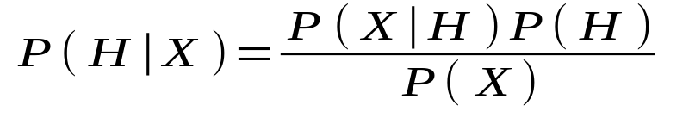
Bayesian Theorem
Given training data X, posteriori probability of a hypothesis H, P(H|X), follows the Bayes theorem
Informally, this can be written as
  posteriori = likelihood x prior/evidence
Predicts X belongs to C₂ iff the probability P(C_{i}|X) is the highest among all the P(C_{k}|X) for all the k classes
Practical difficulty: require initial knowledge of many probabilities, significant computational cost
03/30/21
Data Mining: Concepts and Techniques

Slide 42
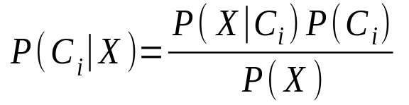

Towards Naïve Bayesian Classifier
Let D be a training set of tuples and their associated class labels, and each tuple is represented by an n-D attribute vector X = (x₁, x₂, …, x_{n})
Suppose there are m classes C₁, C₂, …, C_{m}.
Classification is to derive the maximum posteriori, i.e., the maximal P(C_{i}|X)
This can be derived from Bayes’ theorem
Since P(X) is constant for all classes, only
needs to be maximized
03/30/21
Data Mining: Concepts and Techniques

Slide 43
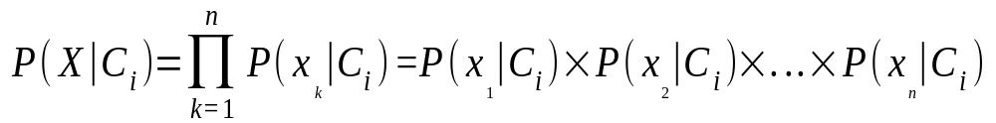
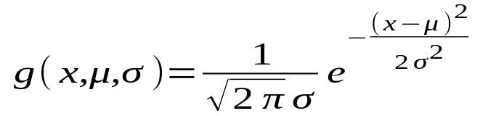
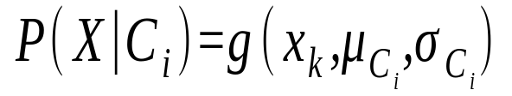
Derivation of Naïve Bayes Classifier
A simplified assumption: attributes are conditionally independent (i.e., no dependence relation between attributes):
This greatly reduces the computation cost: Only counts the class distribution
If A_{k} is categorical, P(x_{k}|C_{i}) is the # of tuples in C_{i} having value x_{k} for A_{k} divided by |C_{i, D}| (# of tuples of C_{i} in D)
If A_{k} is continous-valued, P(x_{k}|C_{i}) is usually computed based on Gaussian distribution with a mean μ and standard deviation σ
  and P(x_{k}|C_{i}) is
03/30/21
Data Mining: Concepts and Techniques

Slide 44

Naïve Bayesian Classifier: Training Dataset
Class:
C1:buys_computer = ‘yes’
C2:buys_computer = ‘no’
Data sample
X = (age <=30,
Income = medium,
Student = yes
Credit_rating = Fair)
03/30/21
Data Mining: Concepts and Techniques

Slide 45
Naïve Bayesian Classifier: An Example
P(C_{i}): P(buys_computer = “yes”) = 9/14 = 0.643
P(buys_computer = “no”) = 5/14= 0.357
Compute P(X|C_{i}) for each class
P(age = “<=30” | buys_computer = “yes”) = 2/9 = 0.222
P(age = “<= 30” | buys_computer = “no”) = 3/5 = 0.6
P(income = “medium” | buys_computer = “yes”) = 4/9 = 0.444
P(income = “medium” | buys_computer = “no”) = 2/5 = 0.4
P(student = “yes” | buys_computer = “yes) = 6/9 = 0.667
P(student = “yes” | buys_computer = “no”) = 1/5 = 0.2
P(credit_rating = “fair” | buys_computer = “yes”) = 6/9 = 0.667
P(credit_rating = “fair” | buys_computer = “no”) = 2/5 = 0.4
X = (age <= 30 , income = medium, student = yes, credit_rating = fair)
P(X|C_{i}) : P(X|buys_computer = “yes”) = 0.222 x 0.444 x 0.667 x 0.667 = 0.044
P(X|buys_computer = “no”) = 0.6 x 0.4 x 0.2 x 0.4 = 0.019
P(X|C_{i})*P(C_{i}) : P(X|buys_computer = “yes”) * P(buys_computer = “yes”) = 0.028
P(X|buys_computer = “no”) * P(buys_computer = “no”) = 0.007
Therefore, X belongs to class (“buys_computer = yes”)
03/30/21

Slide 46
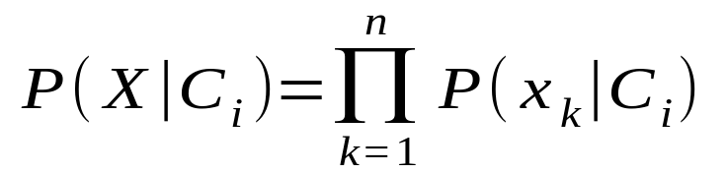
Avoiding the 0-Probability Problem
Naïve Bayesian prediction requires each conditional prob. be non-zero. Otherwise, the predicted prob. will be zero
Ex. Suppose a dataset with 1000 tuples, income=low (0), income= medium (990), and income = high (10),
Use Laplacian correction (or Laplacian estimator)
  Adding 1 to each case
    Prob(income = low) = 1/1003
    Prob(income = medium) = 991/1003
    Prob(income = high) = 11/1003
  The “corrected” prob. estimates are close to their “uncorrected” counterparts
03/30/21
Data Mining: Concepts and Techniques

Slide 47
Naïve Bayesian Classifier: Comments
Advantages
  Easy to implement
  Good results obtained in most of the cases
Disadvantages
  Assumption: class conditional independence, therefore loss of accuracy
  Practically, dependencies exist among variables
    E.g., hospitals: patients: Profile: age, family history, etc.
    Symptoms: fever, cough etc., Disease: lung cancer, diabetes, etc.
    Dependencies among these cannot be modeled by Naïve Bayesian Classifier
How to deal with these dependencies?
  Bayesian Belief Networks
03/30/21
Data Mining: Concepts and Techniques

Slide 48
Bayesian Belief Networks
Bayesian belief network allows a subset of the variables conditionally independent
A graphical model of causal relationships
  Represents dependency among the variables
  Gives a specification of joint probability distribution
Nodes: random variables
Links: dependency
X and Y are the parents of Z, and Y is the parent of P
No dependency between Z and P
Has no loops or cycles
X
Y
Z
P
03/30/21
Data Mining: Concepts and Techniques

Slide 49
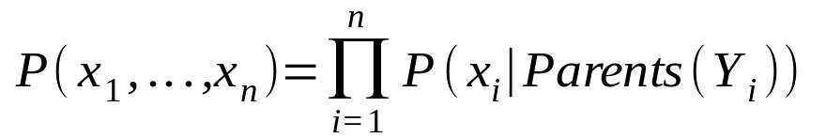
Bayesian Belief Network: An Example
Family
History
Smoker
The conditional probability table (CPT) for variable LungCancer:
(FH, S)
(FH, ~S)
(~FH, S)
(~FH, ~S)
LC
0.8
0.5
0.7
0.1
LungCancer
Emphysema
~LC
0.2
0.5
0.3
0.9
CPT shows the conditional probability for each possible combination of its parents
PositiveXRay
Dyspnea
Derivation of the probability of a particular combination of values of X, from CPT:
Bayesian Belief Networks
03/30/21
Data Mining: Concepts and Techniques

Slide 50
Training Bayesian Networks
Several scenarios:
  Given both the network structure and all variables observable: learn only the CPTs
  Network structure known, some hidden variables: gradient descent (greedy hill-climbing) method, analogous to neural network learning
  Network structure unknown, all variables observable: search through the model space to reconstruct network topology
  Unknown structure, all hidden variables: No good algorithms known for this purpose
Ref. D. Heckerman: Bayesian networks for data mining
03/30/21
Data Mining: Concepts and Techniques

Slide 51
Chapter 6. Classification and Prediction
What is classification? What is prediction?
Issues regarding classification and prediction
Classification by decision tree induction
Bayesian classification
Rule-based classification
Classification by back propagation
Support Vector Machines (SVM)
Associative classification
Lazy learners (or learning from your neighbors)
Other classification methods
Prediction
Accuracy and error measures
Ensemble methods
Model selection
Summary
03/30/21
Data Mining: Concepts and Techniques

Slide 52
Using IF-THEN Rules for Classification
Represent the knowledge in the form of IF-THEN rules
  R: IF age = youth AND student = yes THEN buys_computer = yes
  Rule antecedent/precondition vs. rule consequent
Assessment of a rule: coverage and accuracy
  n_{covers} = # of tuples covered by R
  n_{correct} = # of tuples correctly classified by R
  coverage(R) = n_{covers} /|D| /* D: training data set */
  accuracy(R) = n_{correct} / n_{covers}
If more than one rule is triggered, need conflict resolution
  Size ordering: assign the highest priority to the triggering rules that has the “toughest” requirement (i.e., with the most attribute test)
  Class-based ordering: decreasing order of prevalence or misclassification cost per class
  Rule-based ordering (decision list): rules are organized into one long priority list, according to some measure of rule quality or by experts
03/30/21
Data Mining: Concepts and Techniques

Slide 53
Rule Extraction from a Decision Tree
age?
<=30
31..40
>40
Rules are easier to understand than large trees
One rule is created for each path from the root to a leaf
Each attribute-value pair along a path forms a conjunction: the leaf holds the class prediction
Rules are mutually exclusive and exhaustive
student?
yes
credit rating?
no
yes
excellent
fair
no
yes
no
yes
Example: Rule extraction from our buys_computer decision-tree
  IF age = young AND student = no THEN buys_computer = no
  IF age = young AND student = yes THEN buys_computer = yes
  IF age = mid-age THEN buys_computer = yes
  IF age = old AND credit_rating = excellent THEN buys_computer = yes
  IF age = young AND credit_rating = fair THEN buys_computer = no
03/30/21
Data Mining: Concepts and Techniques

Slide 54
Rule Extraction from the Training Data
Sequential covering algorithm: Extracts rules directly from training data
Typical sequential covering algorithms: FOIL, AQ, CN2, RIPPER
Rules are learned sequentially, each for a given class C_{i} will cover many tuples of C_{i} but none (or few) of the tuples of other classes
Steps:
  Rules are learned one at a time
  Each time a rule is learned, the tuples covered by the rules are removed
  The process repeats on the remaining tuples unless termination condition, e.g., when no more training examples or when the quality of a rule returned is below a user-specified threshold
Comp. w. decision-tree induction: learning a set of rules simultaneously
03/30/21
Data Mining: Concepts and Techniques

Slide 55
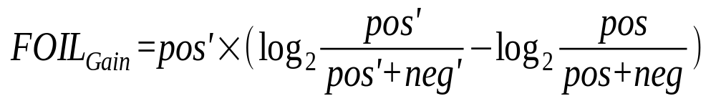
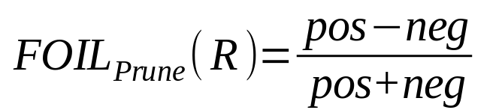
How to Learn-One-Rule?
Star with the most general rule possible: condition = empty
Adding new attributes by adopting a greedy depth-first strategy
  Picks the one that most improves the rule quality
Rule-Quality measures: consider both coverage and accuracy
  Foil-gain (in FOIL & RIPPER): assesses info_gain by extending condition
    It favors rules that have high accuracy and cover many positive tuples
Rule pruning based on an independent set of test tuples
    Pos/neg are # of positive/negative tuples covered by R.
    If FOIL_Prune is higher for the pruned version of R, prune R
03/30/21
Data Mining: Concepts and Techniques

Slide 56
Chapter 6. Classification and Prediction
What is classification? What is prediction?
Issues regarding classification and prediction
Classification by decision tree induction
Bayesian classification
Rule-based classification
Classification by back propagation
Support Vector Machines (SVM)
Associative classification
Lazy learners (or learning from your neighbors)
Other classification methods
Prediction
Accuracy and error measures
Ensemble methods
Model selection
Summary
03/30/21
Data Mining: Concepts and Techniques

Slide 57
Classification: A Mathematical Mapping
Classification:
  predicts categorical class labels
E.g., Personal homepage classification
  x_{i} = (x₁, x₂, x₃, …), y_{i} = +1 or –1
  x₁ : # of a word “homepage”
  x₂ : # of a word “welcome”
Mathematically
  x ∈ X = ℜ^{n}, y ∈ Y = {+1, –1}
  We want a function f: X → Y
03/30/21
Data Mining: Concepts and Techniques

Slide 58
Linear Classification
Binary Classification problem
The data above the red line belongs to class ‘x’
The data below red line belongs to class ‘o’
Examples: SVM, Perceptron, Probabilistic Classifiers
x
x
x
x
x
x
x
x
o
x
o
x
o
o
o
o
o
o
o
o
o
o
o
03/30/21
Data Mining: Concepts and Techniques

Slide 59
Discriminative Classifiers
Advantages
  prediction accuracy is generally high
    As compared to Bayesian methods – in general
  robust, works when training examples contain errors
  fast evaluation of the learned target function
    Bayesian networks are normally slow
Criticism
  long training time
  difficult to understand the learned function (weights)
    Bayesian networks can be used easily for pattern discovery
  not easy to incorporate domain knowledge
    Easy in the form of priors on the data or distributions
03/30/21
Data Mining: Concepts and Techniques

Slide 60
Perceptron & Winnow
Vector: x, w
Scalar: x, y, w
Input: {(x₁, y₁), …}
Output: classification function f(x)
f(x_{i}) > 0 for y_{i} = +1
f(x_{i}) < 0 for y_{i} = -1
f(x) => wx + b = 0
or w₁x₁+w₂x₂+b = 0
x₂
Perceptron: update W additively
Winnow: update W multiplicatively
x₁
03/30/21
Data Mining: Concepts and Techniques

Slide 61
Classification by Backpropagation
Backpropagation: A neural network learning algorithm
Started by psychologists and neurobiologists to develop and test computational analogues of neurons
A neural network: A set of connected input/output units where each connection has a weight associated with it
During the learning phase, the network learns by adjusting the weights so as to be able to predict the correct class label of the input tuples
Also referred to as connectionist learning due to the connections between units
03/30/21
Data Mining: Concepts and Techniques

Slide 62
Neural Network as a Classifier
Weakness
  Long training time
  Require a number of parameters typically best determined empirically, e.g., the network topology or ``structure."
  Poor interpretability: Difficult to interpret the symbolic meaning behind the learned weights and of ``hidden units" in the network
Strength
  High tolerance to noisy data
  Ability to classify untrained patterns
  Well-suited for continuous-valued inputs and outputs
  Successful on a wide array of real-world data
  Algorithms are inherently parallel
  Techniques have recently been developed for the extraction of rules from trained neural networks
03/30/21
Data Mining: Concepts and Techniques

Slide 63
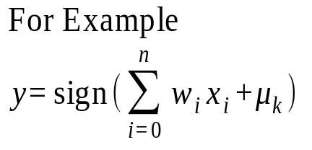
A Neuron (= a perceptron)
-
μ_{k}
x₀
w₀
x₁
w₁
∑
f
output y
x_{n}
w_{n}
Input
vector x
weight
vector w
weighted
sum
Activation
function
The n-dimensional input vector x is mapped into variable y by means of the scalar product and a nonlinear function mapping
03/30/21
Data Mining: Concepts and Techniques

Slide 64
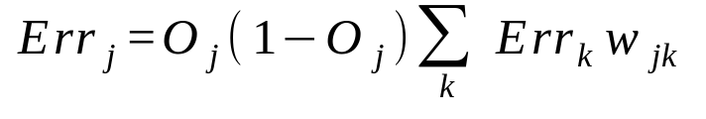



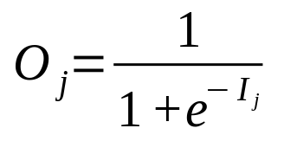
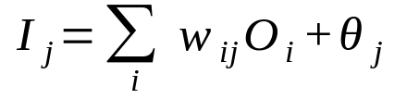
A Multi-Layer Feed-Forward Neural Network
Output vector
Output layer
Hidden layer
w_{ij}
Input layer
Input vector: X
03/30/21
Data Mining: Concepts and Techniques

Slide 65
How A Multi-Layer Neural Network Works?
The inputs to the network correspond to the attributes measured for each training tuple
Inputs are fed simultaneously into the units making up the input layer
They are then weighted and fed simultaneously to a hidden layer
The number of hidden layers is arbitrary, although usually only one
The weighted outputs of the last hidden layer are input to units making up the output layer, which emits the network's prediction
The network is feed-forward in that none of the weights cycles back to an input unit or to an output unit of a previous layer
From a statistical point of view, networks perform nonlinear regression: Given enough hidden units and enough training samples, they can closely approximate any function
03/30/21
Data Mining: Concepts and Techniques

Slide 66
Defining a Network Topology
First decide the network topology: # of units in the input layer, # of hidden layers (if > 1), # of units in each hidden layer, and # of units in the output layer
Normalizing the input values for each attribute measured in the training tuples to [0.0—1.0]
One input unit per domain value, each initialized to 0
Output, if for classification and more than two classes, one output unit per class is used
Once a network has been trained and its accuracy is unacceptable, repeat the training process with a different network topology or a different set of initial weights
03/30/21
Data Mining: Concepts and Techniques

Slide 67
Backpropagation
Iteratively process a set of training tuples & compare the network's prediction with the actual known target value
For each training tuple, the weights are modified to minimize the mean squared error between the network's prediction and the actual target value
Modifications are made in the “backwards” direction: from the output layer, through each hidden layer down to the first hidden layer, hence “backpropagation”
Steps
  Initialize weights (to small random #s) and biases in the network
  Propagate the inputs forward (by applying activation function)
  Backpropagate the error (by updating weights and biases)
  Terminating condition (when error is very small, etc.)
03/30/21
Data Mining: Concepts and Techniques

Slide 68
Backpropagation and Interpretability
Efficiency of backpropagation: Each epoch (one interation through the training set) takes O(|D| * w), with |D| tuples and w weights, but # of epochs can be exponential to n, the number of inputs, in the worst case
Rule extraction from networks: network pruning
  Simplify the network structure by removing weighted links that have the least effect on the trained network
  Then perform link, unit, or activation value clustering
  The set of input and activation values are studied to derive rules describing the relationship between the input and hidden unit layers
Sensitivity analysis: assess the impact that a given input variable has on a network output. The knowledge gained from this analysis can be represented in rules
03/30/21
Data Mining: Concepts and Techniques

Slide 69
Chapter 6. Classification and Prediction
What is classification? What is prediction?
Issues regarding classification and prediction
Classification by decision tree induction
Bayesian classification
Rule-based classification
Classification by back propagation
Support Vector Machines (SVM)
Associative classification
Lazy learners (or learning from your neighbors)
Other classification methods
Prediction
Accuracy and error measures
Ensemble methods
Model selection
Summary
03/30/21
Data Mining: Concepts and Techniques

Slide 70
SVM—Support Vector Machines
A new classification method for both linear and nonlinear data
It uses a nonlinear mapping to transform the original training data into a higher dimension
With the new dimension, it searches for the linear optimal separating hyperplane (i.e., “decision boundary”)
With an appropriate nonlinear mapping to a sufficiently high dimension, data from two classes can always be separated by a hyperplane
SVM finds this hyperplane using support vectors (“essential” training tuples) and margins (defined by the support vectors)
03/30/21
Data Mining: Concepts and Techniques

Slide 71
SVM—History and Applications
Vapnik and colleagues (1992)—groundwork from Vapnik & Chervonenkis’ statistical learning theory in 1960s
Features: training can be slow but accuracy is high owing to their ability to model complex nonlinear decision boundaries (margin maximization)
Used both for classification and prediction
Applications:
  handwritten digit recognition, object recognition, speaker identification, benchmarking time-series prediction tests
03/30/21
Data Mining: Concepts and Techniques

Slide 72
SVM—General Philosophy
Small Margin
Large Margin
Support Vectors
03/30/21
Data Mining: Concepts and Techniques

Slide 73


SVM—Margins and Support Vectors
03/30/21
Data Mining: Concepts and Techniques

Slide 74
SVM—When Data Is Linearly Separable
m
Let data D be (X₁, y₁), …, (X_{|D|}, y_{|D|}), where X_{i} is the set of training tuples associated with the class labels y_{i}
There are infinite lines (hyperplanes) separating the two classes but we want to find the best one (the one that minimizes classification error on unseen data)
SVM searches for the hyperplane with the largest margin, i.e., maximum marginal hyperplane (MMH)
03/30/21
Data Mining: Concepts and Techniques

Slide 75
SVM—Linearly Separable
A separating hyperplane can be written as
    W ● X + b = 0
  where W={w₁, w₂, …, w_{n}} is a weight vector and b a scalar (bias)
For 2-D it can be written as
    w₀ + w₁ x₁ + w₂ x₂ = 0
The hyperplane defining the sides of the margin:
    H₁: w₀ + w₁ x₁ + w₂ x₂ ≥ 1 for y_{i} = +1, and
    H₂: w₀ + w₁ x₁ + w₂ x₂ ≤ – 1 for y_{i} = –1
Any training tuples that fall on hyperplanes H₁ or H₂ (i.e., the
sides defining the margin) are support vectors
This becomes a constrained (convex) quadratic optimization problem: Quadratic objective function and linear constraints → Quadratic Programming (QP) → Lagrangian multipliers
03/30/21
Data Mining: Concepts and Techniques

Slide 76
Why Is SVM Effective on High Dimensional Data?
The complexity of trained classifier is characterized by the # of support vectors rather than the dimensionality of the data
The support vectors are the essential or critical training examples —they lie closest to the decision boundary (MMH)
If all other training examples are removed and the training is repeated, the same separating hyperplane would be found
The number of support vectors found can be used to compute an (upper) bound on the expected error rate of the SVM classifier, which is independent of the data dimensionality
Thus, an SVM with a small number of support vectors can have good generalization, even when the dimensionality of the data is high
03/30/21
Data Mining: Concepts and Techniques

Slide 77


SVM—Linearly Inseparable
Transform the original input data into a higher dimensional space
Search for a linear separating hyperplane in the new space
03/30/21
Data Mining: Concepts and Techniques

Slide 78
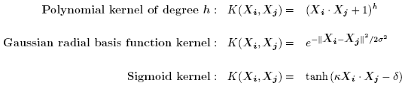
SVM—Kernel functions
Instead of computing the dot product on the transformed data tuples, it is mathematically equivalent to instead applying a kernel function K(X_{i}, X_{j}) to the original data, i.e., K(X_{i}, X_{j}) = Φ(X_{i}) Φ(X_{j})
Typical Kernel Functions
SVM can also be used for classifying multiple (> 2) classes and for regression analysis (with additional user parameters)
03/30/21
Data Mining: Concepts and Techniques

Slide 79
Scaling SVM by Hierarchical Micro-Clustering
SVM is not scalable to the number of data objects in terms of training time and memory usage
“Classifying Large Datasets Using SVMs with Hierarchical Clusters Problem” by Hwanjo Yu, Jiong Yang, Jiawei Han, KDD’03
CB-SVM (Clustering-Based SVM)
  Given limited amount of system resources (e.g., memory), maximize the SVM performance in terms of accuracy and the training speed
  Use micro-clustering to effectively reduce the number of points to be considered
  At deriving support vectors, de-cluster micro-clusters near “candidate vector” to ensure high classification accuracy
03/30/21
Data Mining: Concepts and Techniques

Slide 80
CB-SVM: Clustering-Based SVM
Training data sets may not even fit in memory
Read the data set once (minimizing disk access)
  Construct a statistical summary of the data (i.e., hierarchical clusters) given a limited amount of memory
  The statistical summary maximizes the benefit of learning SVM
The summary plays a role in indexing SVMs
Essence of Micro-clustering (Hierarchical indexing structure)
  Use micro-cluster hierarchical indexing structure
    provide finer samples closer to the boundary and coarser samples farther from the boundary
  Selective de-clustering to ensure high accuracy
03/30/21
Data Mining: Concepts and Techniques

Slide 81
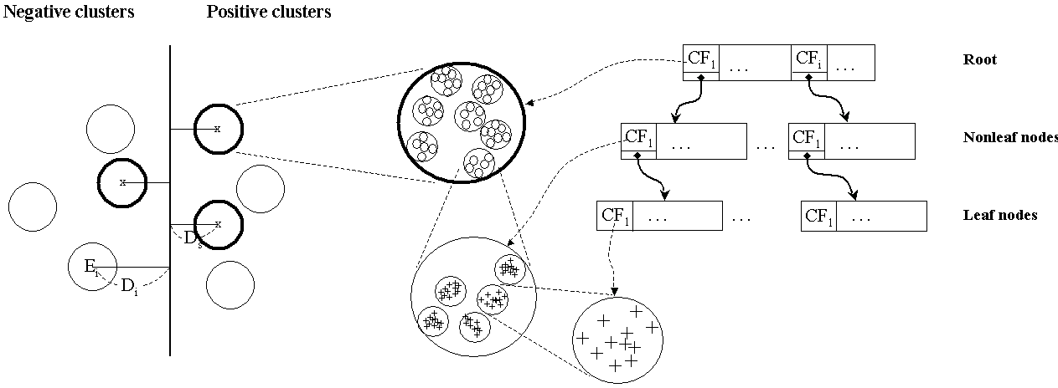
CF-Tree: Hierarchical Micro-cluster
03/30/21
Data Mining: Concepts and Techniques

Slide 82
CB-SVM Algorithm: Outline
Construct two CF-trees from positive and negative data sets independently
  Need one scan of the data set
Train an SVM from the centroids of the root entries
De-cluster the entries near the boundary into the next level
  The children entries de-clustered from the parent entries are accumulated into the training set with the non-declustered parent entries
Train an SVM again from the centroids of the entries in the training set
Repeat until nothing is accumulated
03/30/21
Data Mining: Concepts and Techniques

Slide 83
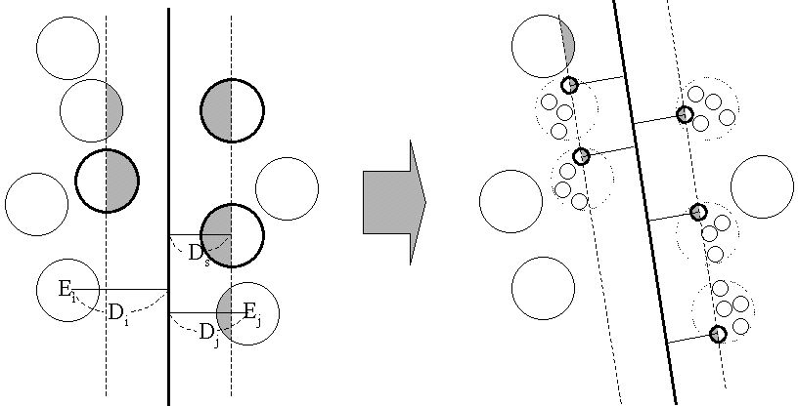
Selective Declustering
CF tree is a suitable base structure for selective declustering
De-cluster only the cluster E_{i} such that
  D_{i} – R_{i} < D_{s}, where D_{i} is the distance from the boundary to the center point of E_{i} and R_{i} is the radius of E_{i}
  Decluster only the cluster whose subclusters have possibilities to be the support cluster of the boundary
    “Support cluster”: The cluster whose centroid is a support vector
03/30/21
Data Mining: Concepts and Techniques

Slide 84
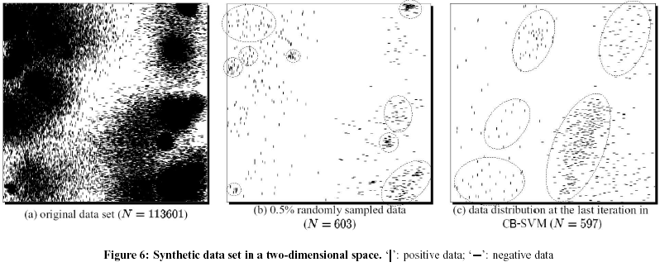
Experiment on Synthetic Dataset
03/30/21
Data Mining: Concepts and Techniques

Slide 85
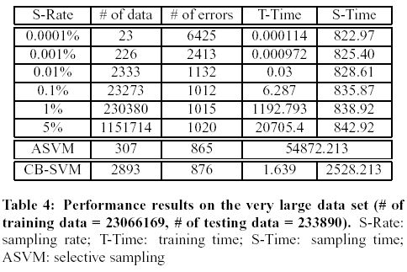
Experiment on a Large Data Set
03/30/21
Data Mining: Concepts and Techniques

Slide 86
SVM vs. Neural Network
SVM
  Relatively new concept
  Deterministic algorithm
  Nice Generalization properties
  Hard to learn – learned in batch mode using quadratic programming techniques
  Using kernels can learn very complex functions
Neural Network
  Relatively old
  Nondeterministic algorithm
  Generalizes well but doesn’t have strong mathematical foundation
  Can easily be learned in incremental fashion
  To learn complex functions—use multilayer perceptron (not that trivial)
03/30/21
Data Mining: Concepts and Techniques

Slide 87
SVM Related Links
SVM Website
  http://www.kernel-machines.org/
Representative implementations
  LIBSVM: an efficient implementation of SVM, multi-class classifications, nu-SVM, one-class SVM, including also various interfaces with java, python, etc.
  SVM-light: simpler but performance is not better than LIBSVM, support only binary classification and only C language
  SVM-torch: another recent implementation also written in C.
03/30/21
Data Mining: Concepts and Techniques

Slide 88
SVM—Introduction Literature
“Statistical Learning Theory” by Vapnik: extremely hard to understand, containing many errors too.
C. J. C. Burges. A Tutorial on Support Vector Machines for Pattern Recognition. Knowledge Discovery and Data Mining, 2(2), 1998.
  Better than the Vapnik’s book, but still written too hard for introduction, and the examples are so not-intuitive
The book “An Introduction to Support Vector Machines” by N. Cristianini and J. Shawe-Taylor
  Also written hard for introduction, but the explanation about the mercer’s theorem is better than above literatures
The neural network book by Haykins
  Contains one nice chapter of SVM introduction
03/30/21
Data Mining: Concepts and Techniques

Slide 89
Chapter 6. Classification and Prediction
What is classification? What is prediction?
Issues regarding classification and prediction
Classification by decision tree induction
Bayesian classification
Rule-based classification
Classification by back propagation
Support Vector Machines (SVM)
Associative classification
Lazy learners (or learning from your neighbors)
Other classification methods
Prediction
Accuracy and error measures
Ensemble methods
Model selection
Summary
03/30/21
Data Mining: Concepts and Techniques

Slide 90
Associative Classification
Associative classification
  Association rules are generated and analyzed for use in classification
  Search for strong associations between frequent patterns (conjunctions of attribute-value pairs) and class labels
  Classification: Based on evaluating a set of rules in the form of
      P₁ ^ p₂ … ^ p_{l} → “A_{class} = C” (conf, sup)
Why effective?
  It explores highly confident associations among multiple attributes and may overcome some constraints introduced by decision-tree induction, which considers only one attribute at a time
  In many studies, associative classification has been found to be more accurate than some traditional classification methods, such as C4.5
03/30/21
Data Mining: Concepts and Techniques

Slide 91
Typical Associative Classification Methods
CBA (Classification By Association: Liu, Hsu & Ma, KDD’98)
  Mine association possible rules in the form of
    Cond-set (a set of attribute-value pairs) → class label
  Build classifier: Organize rules according to decreasing precedence based on confidence and then support
CMAR (Classification based on Multiple Association Rules: Li, Han, Pei, ICDM’01)
  Classification: Statistical analysis on multiple rules
CPAR (Classification based on Predictive Association Rules: Yin & Han, SDM’03)
  Generation of predictive rules (FOIL-like analysis)
  High efficiency, accuracy similar to CMAR
RCBT (Mining top-k covering rule groups for gene expression data, Cong et al. SIGMOD’05)
  Explore high-dimensional classification, using top-k rule groups
  Achieve high classification accuracy and high run-time efficiency
03/30/21
Data Mining: Concepts and Techniques

Slide 92
A Closer Look at CMAR
CMAR (Classification based on Multiple Association Rules: Li, Han, Pei, ICDM’01)
Efficiency: Uses an enhanced FP-tree that maintains the distribution of class labels among tuples satisfying each frequent itemset
Rule pruning whenever a rule is inserted into the tree
  Given two rules, R₁ and R₂, if the antecedent of R₁ is more general than that of R₂ and conf(R₁) ≥ conf(R₂), then R₂ is pruned
  Prunes rules for which the rule antecedent and class are not positively correlated, based on a χ² test of statistical significance
Classification based on generated/pruned rules
  If only one rule satisfies tuple X, assign the class label of the rule
  If a rule set S satisfies X, CMAR
    divides S into groups according to class labels
    uses a weighted χ² measure to find the strongest group of rules, based on the statistical correlation of rules within a group
    assigns X the class label of the strongest group
03/30/21
Data Mining: Concepts and Techniques

Slide 93
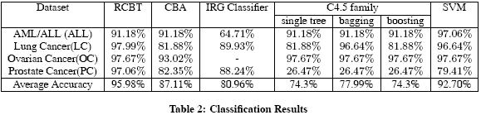
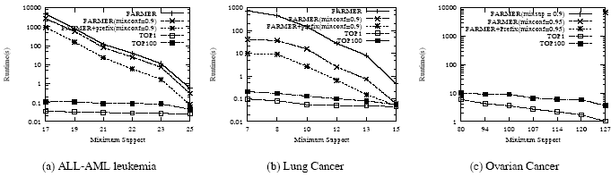
Associative Classification May Achieve High Accuracy and Efficiency (Cong et al. SIGMOD05)
03/30/21
Data Mining: Concepts and Techniques

Slide 94
Chapter 6. Classification and Prediction
What is classification? What is prediction?
Issues regarding classification and prediction
Classification by decision tree induction
Bayesian classification
Rule-based classification
Classification by back propagation
Support Vector Machines (SVM)
Associative classification
Lazy learners (or learning from your neighbors)
Other classification methods
Prediction
Accuracy and error measures
Ensemble methods
Model selection
Summary
03/30/21
Data Mining: Concepts and Techniques

Slide 95
Lazy vs. Eager Learning
Lazy vs. eager learning
  Lazy learning (e.g., instance-based learning): Simply stores training data (or only minor processing) and waits until it is given a test tuple
  Eager learning (the above discussed methods): Given a set of training set, constructs a classification model before receiving new (e.g., test) data to classify
Lazy: less time in training but more time in predicting
Accuracy
  Lazy method effectively uses a richer hypothesis space since it uses many local linear functions to form its implicit global approximation to the target function
  Eager: must commit to a single hypothesis that covers the entire instance space
03/30/21
Data Mining: Concepts and Techniques

Slide 96
Lazy Learner: Instance-Based Methods
Instance-based learning:
  Store training examples and delay the processing (“lazy evaluation”) until a new instance must be classified
Typical approaches
  k-nearest neighbor approach
    Instances represented as points in a Euclidean space.
  Locally weighted regression
    Constructs local approximation
  Case-based reasoning
    Uses symbolic representations and knowledge-based inference
03/30/21
Data Mining: Concepts and Techniques

Slide 97
The k-Nearest Neighbor Algorithm
All instances correspond to points in the n-D space
The nearest neighbor are defined in terms of Euclidean distance, dist(X₁, X₂)
Target function could be discrete- or real- valued
For discrete-valued, k-NN returns the most common value among the k training examples nearest to x_{q}
Vonoroi diagram: the decision surface induced by 1-NN for a typical set of training examples
_
.
_
_
.
+
_
.
+
.
.
_
x_{q}
+
_
.
+
03/30/21
Data Mining: Concepts and Techniques

Slide 98
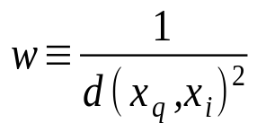
Discussion on the k-NN Algorithm
k-NN for real-valued prediction for a given unknown tuple
  Returns the mean values of the k nearest neighbors
Distance-weighted nearest neighbor algorithm
  Weight the contribution of each of the k neighbors according to their distance to the query x_{q}
    Give greater weight to closer neighbors
Robust to noisy data by averaging k-nearest neighbors
Curse of dimensionality: distance between neighbors could be dominated by irrelevant attributes
  To overcome it, axes stretch or elimination of the least relevant attributes
03/30/21
Data Mining: Concepts and Techniques

Slide 99
Case-Based Reasoning (CBR)
CBR: Uses a database of problem solutions to solve new problems
Store symbolic description (tuples or cases)—not points in a Euclidean space
Applications: Customer-service (product-related diagnosis), legal ruling
Methodology
  Instances represented by rich symbolic descriptions (e.g., function graphs)
  Search for similar cases, multiple retrieved cases may be combined
  Tight coupling between case retrieval, knowledge-based reasoning, and problem solving
Challenges
  Find a good similarity metric
  Indexing based on syntactic similarity measure, and when failure, backtracking, and adapting to additional cases
03/30/21
Data Mining: Concepts and Techniques

Slide 100
Chapter 6. Classification and Prediction
What is classification? What is prediction?
Issues regarding classification and prediction
Classification by decision tree induction
Bayesian classification
Rule-based classification
Classification by back propagation
Support Vector Machines (SVM)
Associative classification
Lazy learners (or learning from your neighbors)
Other classification methods
Prediction
Accuracy and error measures
Ensemble methods
Model selection
Summary
03/30/21
Data Mining: Concepts and Techniques

Slide 101
Genetic Algorithms (GA)
Genetic Algorithm: based on an analogy to biological evolution
An initial population is created consisting of randomly generated rules
  Each rule is represented by a string of bits
  E.g., if A₁ and ¬A₂ then C₂ can be encoded as 100
  If an attribute has k > 2 values, k bits can be used
Based on the notion of survival of the fittest, a new population is formed to consist of the fittest rules and their offsprings
The fitness of a rule is represented by its classification accuracy on a set of training examples
Offsprings are generated by crossover and mutation
The process continues until a population P evolves when each rule in P satisfies a prespecified threshold
Slow but easily parallelizable
03/30/21
Data Mining: Concepts and Techniques

Slide 102

Rough Set Approach
Rough sets are used to approximately or “roughly” define equivalent classes
A rough set for a given class C is approximated by two sets: a lower approximation (certain to be in C) and an upper approximation (cannot be described as not belonging to C)
Finding the minimal subsets (reducts) of attributes for feature reduction is NP-hard but a discernibility matrix (which stores the differences between attribute values for each pair of data tuples) is used to reduce the computation intensity
03/30/21
Data Mining: Concepts and Techniques

Slide 103

Fuzzy Set Approaches
Fuzzy logic uses truth values between 0.0 and 1.0 to represent the degree of membership (such as using fuzzy membership graph)
Attribute values are converted to fuzzy values
  e.g., income is mapped into the discrete categories {low, medium, high} with fuzzy values calculated
For a given new sample, more than one fuzzy value may apply
Each applicable rule contributes a vote for membership in the categories
Typically, the truth values for each predicted category are summed, and these sums are combined
03/30/21
Data Mining: Concepts and Techniques

Slide 104
Chapter 6. Classification and Prediction
What is classification? What is prediction?
Issues regarding classification and prediction
Classification by decision tree induction
Bayesian classification
Rule-based classification
Classification by back propagation
Support Vector Machines (SVM)
Associative classification
Lazy learners (or learning from your neighbors)
Other classification methods
Prediction
Accuracy and error measures
Ensemble methods
Model selection
Summary
03/30/21
Data Mining: Concepts and Techniques

Slide 105
Module 3. Classification
What is classification? What is prediction?
Issues regarding classification and prediction
1. Classification by decision tree induction
Attribute Selection meaures
Tree pruning
2. Bayesian classification
Naive Bayes classifier
Rule-based classification, SVM, Backpropagation, k-Nearest-Neighbor classifiers, GA, fuzzy set
Prediction : structure of regression models
Simple linear regression
Multiple linear regression
Accuracy and error measures
Evaluating the Accuracy
03/30/21
Data Mining: Concepts and Techniques

Slide 106
What Is Prediction?
(Numerical) prediction is similar to classification
  construct a model
  use model to predict continuous or ordered value for a given input
Prediction is different from classification
  Classification refers to predict categorical class label
  Prediction models continuous-valued functions
Major method for prediction: regression
  model the relationship between one or more independent or predictor variables and a dependent or response variable
Regression analysis
  Linear and multiple regression
  Non-linear regression
  Other regression methods: generalized linear model, Poisson regression, log-linear models, regression trees
03/30/21
Data Mining: Concepts and Techniques

Slide 107
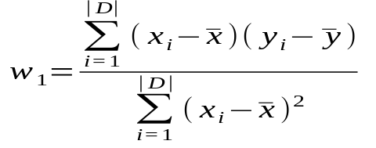
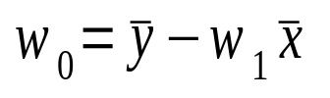
Linear Regression
Linear regression: involves a response variable y and a single predictor variable x
    y = w₀ + w₁ x
  where w₀ (y-intercept) and w₁ (slope) are regression coefficients
Method of least squares: estimates the best-fitting straight line
  Multiple linear regression: involves more than one predictor variable
  Training data is of the form (X₁, y₁), (X₂, y₂),…, (X_{|D|}, y_{|D|})
  Ex. For 2-D data, we may have: y = w₀ + w₁ x₁+ w₂ x₂
  Solvable by extension of least square method or using statistical softwares/languages like SPSS, STATA, SAS, S-Plus, R
  Many nonlinear functions can be transformed into the above

Slide 108
Nonlinear Regression
Some nonlinear models can be modeled by a polynomial function
A polynomial regression model can be transformed into linear regression model. For example,
    y = w₀ + w₁ x + w₂ x² + w₃ x³
  convertible to linear with new variables: x₂ = x², x₃= x³
    y = w₀ + w₁ x + w₂ x₂ + w₃ x₃
Other functions, such as power function, can also be transformed to linear model
Some models are intractable nonlinear (e.g., sum of exponential terms)
  possible to obtain least square estimates through extensive calculation on more complex formulae

Slide 109
Other Regression-Based Models
Generalized linear model:
  Foundation on which linear regression can be applied to modeling categorical response variables
  Variance of y is a function of the mean value of y, not a constant
  Logistic regression: models the prob. of some event occurring as a linear function of a set of predictor variables
  Poisson regression: models the data that exhibit a Poisson distribution
Log-linear models: (for categorical data)
  Approximate discrete multidimensional prob. distributions
  Also useful for data compression and smoothing
Regression trees and model trees
  Trees to predict continuous values rather than class labels
03/30/21

Slide 110
Regression Trees and Model Trees
Regression tree: proposed in CART system (Breiman et al. 1984)
  CART: Classification And Regression Trees
  Each leaf stores a continuous-valued prediction
  It is the average value of the predicted attribute for the training tuples that reach the leaf
Model tree: proposed by Quinlan (1992)
  Each leaf holds a regression model—a multivariate linear equation for the predicted attribute
  A more general case than regression tree
Regression and model trees tend to be more accurate than linear regression when the data are not represented well by a simple linear model

Slide 111
Predictive Modeling in Multidimensional Databases
Predictive modeling: Predict data values or construct generalized linear models based on the database data
One can only predict value ranges or category distributions
Method outline:
  Minimal generalization
  Attribute relevance analysis
  Generalized linear model construction
  Prediction
Determine the major factors which influence the prediction
  Data relevance analysis: uncertainty measurement, entropy analysis, expert judgement, etc.
Multi-level prediction: drill-down and roll-up analysis

Slide 112
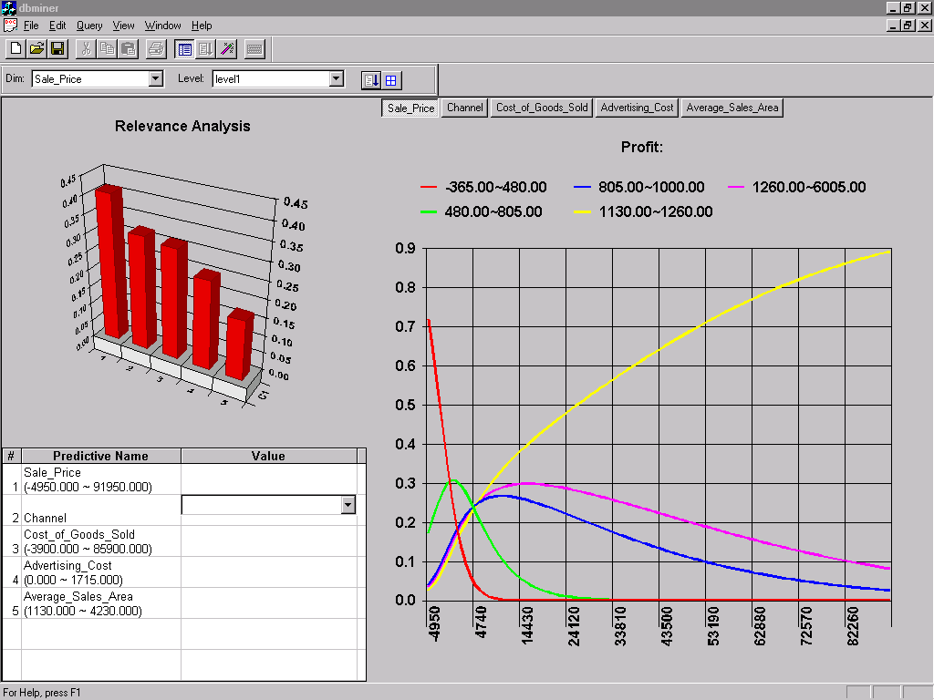
Prediction: Numerical Data

Slide 113
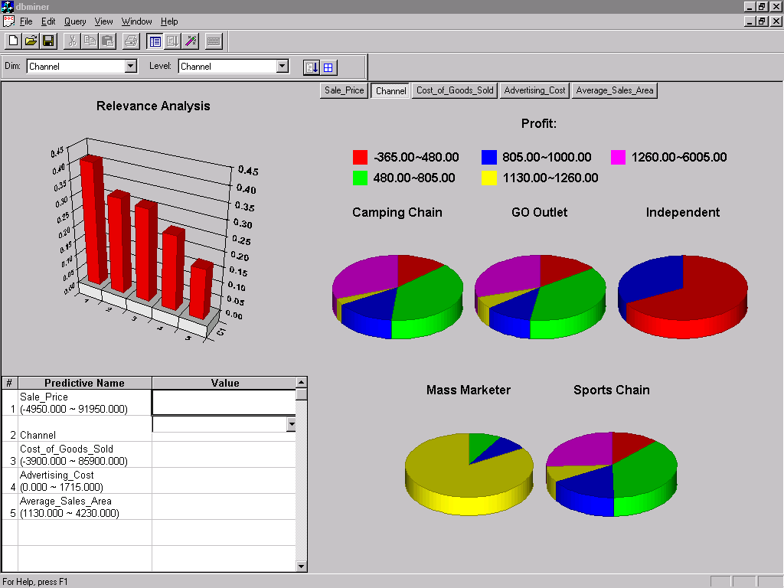
Prediction: Categorical Data

Slide 114
Chapter 6. Classification and Prediction
What is classification? What is prediction?
Issues regarding classification and prediction
Classification by decision tree induction
Bayesian classification
Rule-based classification
Classification by back propagation
Support Vector Machines (SVM)
Associative classification
Lazy learners (or learning from your neighbors)
Other classification methods
Prediction
Accuracy and error measures
Ensemble methods
Model selection
Summary

Slide 115
Module 3. Classification
What is classification? What is prediction?
Issues regarding classification and prediction
1. Classification by decision tree induction
Attribute Selection meaures
Tree pruning
2. Bayesian classification
Naive Bayes classifier
Rule-based classification, SVM, Backpropagation, k-Nearest-Neighbor classifiers, GA, fuzzy set
Prediction : structure of regression models
Simple linear regression
Multiple linear regression
Accuracy and error measures
Evaluating the Accuracy
03/30/21
Data Mining: Concepts and Techniques

Slide 116
 | C₁ | C₂
C₁ | True positive | False negative
C₂ | False positive | True negative
Classifier Accuracy Measures
  Error rate (misclassification rate) of M = 1 – acc(M)
  Given m classes, CM_{i,j}, an entry in a confusion matrix, indicates # of tuples in class i that are labeled by the classifier as class j
Alternative accuracy measures (e.g., for cancer diagnosis)
  sensitivity = t-pos/pos /* true positive recognition rate */
  specificity = t-neg/neg /* true negative recognition rate */
  precision = t-pos/(t-pos + f-pos)
  accuracy = sensitivity * pos/(pos + neg) + specificity * neg/(pos + neg)
  This model can also be used for cost-benefit analysis
Accuracy of a classifier M, acc(M): percentage of test set tuples that are correctly classified by the model M
03/30/21

Slide 117
Classifier Accuracy Measures
classes | buy_computer = yes | buy_computer = no | total | recognition(%)
buy_computer = yes | 6954 | 46 | 7000 | 99.34
buy_computer = no | 412 | 2588 | 3000 | 86.27
total | 7366 | 2634 | 10000 | 95.52
03/30/21
Data Mining: Concepts and Techniques

Slide 118
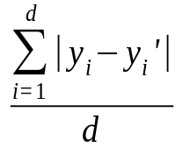
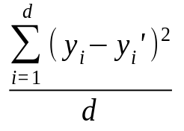
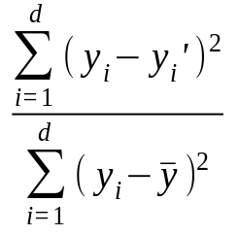
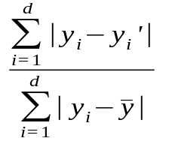
Predictor Error Measures
Measure predictor accuracy: measure how far off the predicted value is from the actual known value
Loss function: measures the error betw. y_{i} and the predicted value y_{i}’
  Absolute error: | y_{i} – y_{i}’|
  Squared error: (y_{i} – y_{i}’)²
Test error (generalization error): the average loss over the test set
  Mean absolute error: Mean squared error:
  Relative absolute error: Relative squared error:
  The mean squared-error exaggerates the presence of outliers
  Popularly use (square) root mean-square error, similarly, root relative squared error

Slide 119
Module 3. Classification
What is classification? What is prediction?
Issues regarding classification and prediction
1. Classification by decision tree induction
Attribute Selection meaures
Tree pruning
2. Bayesian classification
Naive Bayes classifier
Rule-based classification, SVM, Backpropagation, k-Nearest-Neighbor classifiers, GA, fuzzy set
Prediction : structure of regression models
Simple linear regression
Multiple linear regression
Accuracy and error measures
Evaluating the Accuracy
03/30/21
Data Mining: Concepts and Techniques

Slide 120
Evaluating the Accuracy of a Classifier or Predictor (I)
Holdout method
  Given data is randomly partitioned into two independent sets
    Training set (e.g., 2/3) for model construction
    Test set (e.g., 1/3) for accuracy estimation
  Random sampling: a variation of holdout
    Repeat holdout k times, accuracy = avg. of the accuracies obtained
03/30/21
Data Mining: Concepts and Techniques

Slide 121
Evaluating the Accuracy of a Classifier or Predictor (II)
Cross-validation (k-fold, where k = 10 is most popular)
  Randomly partition the data into k mutually exclusive subsets, each approximately equal size
  At i-th iteration, use D_{i} as test set and others as training set
  Leave-one-out: k folds where k = # of tuples, for small sized data
  Stratified cross-validation: folds are stratified so that class dist. in each fold is approx. the same as that in the initial data
03/30/21
Data Mining: Concepts and Techniques

Slide 122
Evaluating the Accuracy of a Classifier or Predictor (III)
Bootstrap
  Works well with small data sets
  Samples the given training tuples uniformly with replacement
    i.e., each time a tuple is selected, it is equally likely to be selected again and re-added to the training set
Several boostrap methods, and a common one is .632 boostrap
03/30/21
Data Mining: Concepts and Techniques

Slide 123
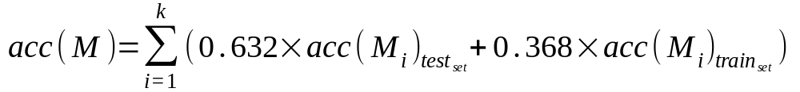
Evaluating the Accuracy of a Classifier or Predictor (IV)
Several boostrap methods, and a common one is .632 boostrap
  Suppose we are given a data set of d tuples. The data set is sampled d times, with replacement, resulting in a training set of d samples. The data tuples that did not make it into the training set end up forming the test set. About 63.2% of the original data will end up in the bootstrap, and the remaining 36.8% will form the test set (since (1 – 1/d)^{d} ≈ e⁻¹ = 0.368)
  Repeat the sampling procedue k times, overall accuracy of the model:
03/30/21
Data Mining: Concepts and Techniques

Slide 124
Module 3. Classification
What is classification? What is prediction?
Issues regarding classification and prediction
1. Classification by decision tree induction
Attribute Selection meaures
Tree pruning
2. Bayesian classification
Naive Bayes classifier
Rule-based classification, SVM, Backpropagation, k-Nearest-Neighbor classifiers, GA, fuzzy set
Prediction : structure of regression models
Simple linear regression
Multiple linear regression
Accuracy and error measures
Evaluating the Accuracy
Summary
03/30/21
Data Mining: Concepts and Techniques

Slide 125
Chapter 6. Classification and Prediction
What is classification? What is prediction?
Issues regarding classification and prediction
Classification by decision tree induction
Bayesian classification
Rule-based classification
Classification by back propagation
Support Vector Machines (SVM)
Associative classification
Lazy learners (or learning from your neighbors)
Other classification methods
Prediction
Accuracy and error measures
Ensemble methods
Model selection
Summary
03/30/21
Data Mining: Concepts and Techniques

Slide 126

Ensemble Methods: Increasing the Accuracy
Ensemble methods
  Use a combination of models to increase accuracy
  Combine a series of k learned models, M₁, M₂, …, M_{k}, with the aim of creating an improved model M*
Popular ensemble methods
  Bagging: averaging the prediction over a collection of classifiers
  Boosting: weighted vote with a collection of classifiers
  Ensemble: combining a set of heterogeneous classifiers
03/30/21

Slide 127
Bagging: Boostrap Aggregation
Analogy: Diagnosis based on multiple doctors’ majority vote
Training
  Given a set D of d tuples, at each iteration i, a training set D_{i} of d tuples is sampled with replacement from D (i.e., boostrap)
  A classifier model M_{i} is learned for each training set D_{i}
Classification: classify an unknown sample X
  Each classifier M_{i} returns its class prediction
  The bagged classifier M* counts the votes and assigns the class with the most votes to X
Prediction: can be applied to the prediction of continuous values by taking the average value of each prediction for a given test tuple
Accuracy
  Often significant better than a single classifier derived from D
  For noise data: not considerably worse, more robust
  Proved improved accuracy in prediction
03/30/21
Data Mining: Concepts and Techniques

Slide 128
Boosting
Analogy: Consult several doctors, based on a combination of weighted diagnoses—weight assigned based on the previous diagnosis accuracy
How boosting works?
  Weights are assigned to each training tuple
  A series of k classifiers is iteratively learned
  After a classifier M_{i} is learned, the weights are updated to allow the subsequent classifier, M_{i+1}, to pay more attention to the training tuples that were misclassified by M_{i}
  The final M* combines the votes of each individual classifier, where the weight of each classifier's vote is a function of its accuracy
The boosting algorithm can be extended for the prediction of continuous values
Comparing with bagging: boosting tends to achieve greater accuracy, but it also risks overfitting the model to misclassified data

Slide 129
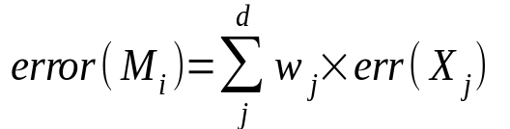

Adaboost (Freund and Schapire, 1997)
Given a set of d class-labeled tuples, (X₁, y₁), …, (X_{d}, y_{d})
Initially, all the weights of tuples are set the same (1/d)
Generate k classifiers in k rounds. At round i,
  Tuples from D are sampled (with replacement) to form a training set D_{i} of the same size
  Each tuple’s chance of being selected is based on its weight
  A classification model M_{i} is derived from D_{i}
  Its error rate is calculated using D_{i} as a test set
  If a tuple is misclssified, its weight is increased, o.w. it is decreased
Error rate: err(X_{j}) is the misclassification error of tuple X_{j}. Classifier M_{i} error rate is the sum of the weights of the misclassified tuples:
The weight of classifier M_{i}’s vote is
03/30/21
Data Mining: Concepts and Techniques

Slide 130
Chapter 6. Classification and Prediction
What is classification? What is prediction?
Issues regarding classification and prediction
Classification by decision tree induction
Bayesian classification
Rule-based classification
Classification by back propagation
Support Vector Machines (SVM)
Associative classification
Lazy learners (or learning from your neighbors)
Other classification methods
Prediction
Accuracy and error measures
Ensemble methods
Model selection
Summary
03/30/21
Data Mining: Concepts and Techniques

Slide 131

Model Selection: ROC Curves
ROC (Receiver Operating Characteristics) curves: for visual comparison of classification models
Originated from signal detection theory
Shows the trade-off between the true positive rate and the false positive rate
The area under the ROC curve is a measure of the accuracy of the model
Rank the test tuples in decreasing order: the one that is most likely to belong to the positive class appears at the top of the list
The closer to the diagonal line (i.e., the closer the area is to 0.5), the less accurate is the model
Vertical axis represents the true positive rate
Horizontal axis rep. the false positive rate
The plot also shows a diagonal line
A model with perfect accuracy will have an area of 1.0
03/30/21
Data Mining: Concepts and Techniques

Slide 132
Chapter 6. Classification and Prediction
What is classification? What is prediction?
Issues regarding classification and prediction
Classification by decision tree induction
Bayesian classification
Rule-based classification
Classification by back propagation
Support Vector Machines (SVM)
Associative classification
Lazy learners (or learning from your neighbors)
Other classification methods
Prediction
Accuracy and error measures
Ensemble methods
Model selection
Summary

Slide 133
Summary (I)
Classification and prediction are two forms of data analysis that can be used to extract models describing important data classes or to predict future data trends.
Effective and scalable methods have been developed for decision trees induction, Naive Bayesian classification, Bayesian belief network, rule-based classifier, Backpropagation, Support Vector Machine (SVM), associative classification, nearest neighbor classifiers, and case-based reasoning, and other classification methods such as genetic algorithms, rough set and fuzzy set approaches.
Linear, nonlinear, and generalized linear models of regression can be used for prediction. Many nonlinear problems can be converted to linear problems by performing transformations on the predictor variables. Regression trees and model trees are also used for prediction.

Slide 134
Summary (II)
Stratified k-fold cross-validation is a recommended method for accuracy estimation. Bagging and boosting can be used to increase overall accuracy by learning and combining a series of individual models.
Significance tests and ROC curves are useful for model selection
There have been numerous comparisons of the different classification and prediction methods, and the matter remains a research topic
No single method has been found to be superior over all others for all data sets
Issues such as accuracy, training time, robustness, interpretability, and scalability must be considered and can involve trade-offs, further complicating the quest for an overall superior method

Slide 135
References (1)
C. Apte and S. Weiss. Data mining with decision trees and decision rules. Future Generation Computer Systems, 13, 1997.
C. M. Bishop, Neural Networks for Pattern Recognition. Oxford University Press, 1995.
L. Breiman, J. Friedman, R. Olshen, and C. Stone. Classification and Regression Trees. Wadsworth International Group, 1984.
C. J. C. Burges. A Tutorial on Support Vector Machines for Pattern Recognition. Data Mining and Knowledge Discovery, 2(2): 121-168, 1998.
P. K. Chan and S. J. Stolfo. Learning arbiter and combiner trees from partitioned data for scaling machine learning. KDD'95.
W. Cohen. Fast effective rule induction. ICML'95.
G. Cong, K.-L. Tan, A. K. H. Tung, and X. Xu. Mining top-k covering rule groups for gene expression data. SIGMOD'05.
A. J. Dobson. An Introduction to Generalized Linear Models. Chapman and Hall, 1990.
G. Dong and J. Li. Efficient mining of emerging patterns: Discovering trends and differences. KDD'99.
Data Mining: Concepts and Techniques

Slide 136
References (2)
R. O. Duda, P. E. Hart, and D. G. Stork. Pattern Classification, 2ed. John Wiley and Sons, 2001
U. M. Fayyad. Branching on attribute values in decision tree generation. AAAI’94.
Y. Freund and R. E. Schapire. A decision-theoretic generalization of on-line learning and an application to boosting. J. Computer and System Sciences, 1997.
J. Gehrke, R. Ramakrishnan, and V. Ganti. Rainforest: A framework for fast decision tree construction of large datasets. VLDB’98.
J. Gehrke, V. Gant, R. Ramakrishnan, and W.-Y. Loh, BOAT -- Optimistic Decision Tree Construction. SIGMOD'99.
T. Hastie, R. Tibshirani, and J. Friedman. The Elements of Statistical Learning: Data Mining, Inference, and Prediction. Springer-Verlag, 2001.
D. Heckerman, D. Geiger, and D. M. Chickering. Learning Bayesian networks: The combination of knowledge and statistical data. Machine Learning, 1995.
M. Kamber, L. Winstone, W. Gong, S. Cheng, and J. Han. Generalization and decision tree induction: Efficient classification in data mining. RIDE'97.
B. Liu, W. Hsu, and Y. Ma. Integrating Classification and Association Rule. KDD'98.
W. Li, J. Han, and J. Pei, CMAR: Accurate and Efficient Classification Based on Multiple Class-Association Rules, ICDM'01.

Slide 137
References (3)
T.-S. Lim, W.-Y. Loh, and Y.-S. Shih. A comparison of prediction accuracy, complexity, and training time of thirty-three old and new classification algorithms. Machine Learning, 2000.
J. Magidson. The Chaid approach to segmentation modeling: Chi-squared automatic interaction detection. In R. P. Bagozzi, editor, Advanced Methods of Marketing Research, Blackwell Business, 1994.
M. Mehta, R. Agrawal, and J. Rissanen. SLIQ : A fast scalable classifier for data mining. EDBT'96.
T. M. Mitchell. Machine Learning. McGraw Hill, 1997.
S. K. Murthy, Automatic Construction of Decision Trees from Data: A Multi-Disciplinary Survey, Data Mining and Knowledge Discovery 2(4): 345-389, 1998
J. R. Quinlan. Induction of decision trees. Machine Learning, 1:81-106, 1986.
J. R. Quinlan and R. M. Cameron-Jones. FOIL: A midterm report. ECML’93.
J. R. Quinlan. C4.5: Programs for Machine Learning. Morgan Kaufmann, 1993.
J. R. Quinlan. Bagging, boosting, and c4.5. AAAI'96.

Slide 138
References (4)
R. Rastogi and K. Shim. Public: A decision tree classifier that integrates building and pruning. VLDB’98.
J. Shafer, R. Agrawal, and M. Mehta. SPRINT : A scalable parallel classifier for data mining. VLDB’96.
J. W. Shavlik and T. G. Dietterich. Readings in Machine Learning. Morgan Kaufmann, 1990.
P. Tan, M. Steinbach, and V. Kumar. Introduction to Data Mining. Addison Wesley, 2005.
S. M. Weiss and C. A. Kulikowski. Computer Systems that Learn: Classification and Prediction Methods from Statistics, Neural Nets, Machine Learning, and Expert Systems. Morgan Kaufman, 1991.
S. M. Weiss and N. Indurkhya. Predictive Data Mining. Morgan Kaufmann, 1997.
I. H. Witten and E. Frank. Data Mining: Practical Machine Learning Tools and Techniques, 2ed. Morgan Kaufmann, 2005.
X. Yin and J. Han. CPAR: Classification based on predictive association rules. SDM'03
H. Yu, J. Yang, and J. Han. Classifying large data sets using SVM with hierarchical clusters. KDD'03.

Slide 139

03/30/21
Data Mining: Concepts and Techniques

